Slide 1
Web Engineering
Components and Challenges of Web Application

Slide 2
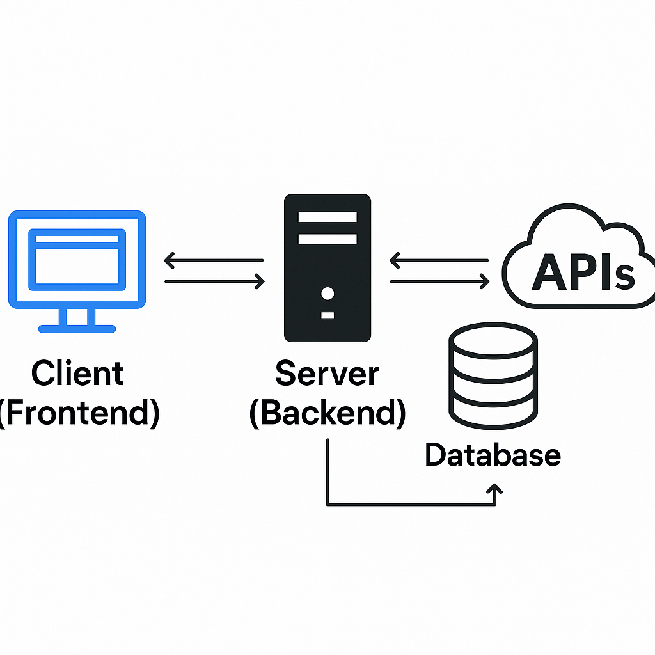
Components of Web Application
Client (Frontend)
Server (Backend)
Database
APIs

Slide 3
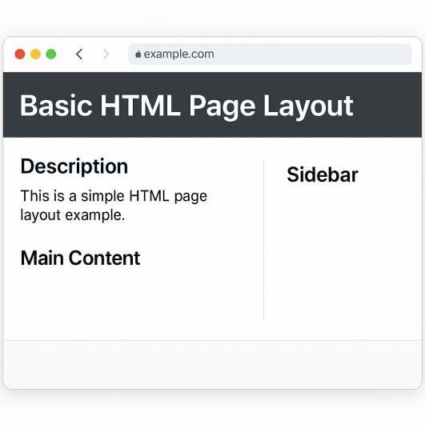
Client (Frontend)
Interface that users interact with
Technologies:
HTML (Structure)
CSS (Styling)
JavaScript (Interactivity)
Frameworks: React, Angular, Vue

Slide 4
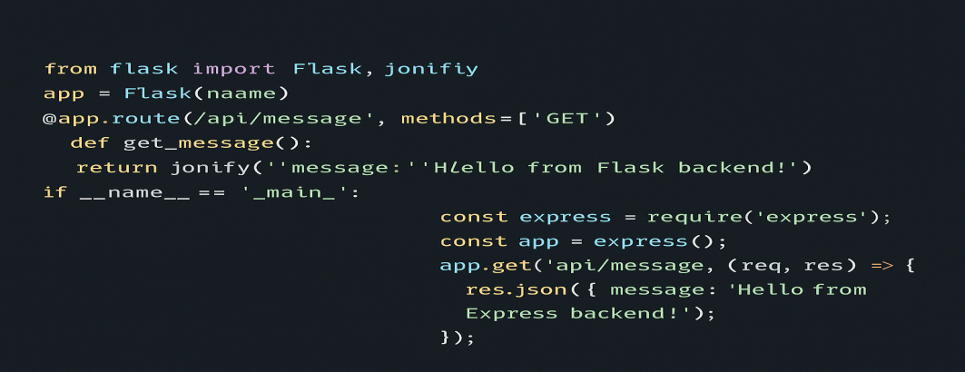
Server (Backend)
Handles business logic, user requests, and communicates with the database
Technologies:
Node.js, Python (Django/Flask), PHP, Java (Spring)
Functions: Authentication, authorization, routing

Slide 5
Database
Store and manage data
Types:
SQL (e.g., MySQL, PostgreSQL)
NoSQL (e.g., MongoDB, Firebase)

Slide 6
APIs
Bridge between frontend and backend
Types:
RESTful APIs
GraphQL
Use Cases: Fetching data, updating records

Slide 7
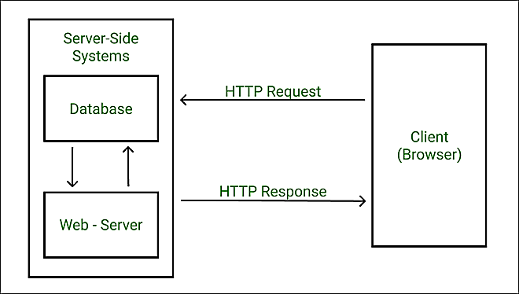
Communication Flow
User sends request via browser
Request hits server
Server processes and queries database
Response sent back to client

Slide 8
Security Components
Includes:
HTTPS
Authentication (JWT, OAuth)
Input validation
CSRF/XSS protection

Slide 9
Challenges of Web Application
key challenges developers face when building web apps
Categories:
Technical
Security
Business/Process
User Experience

Slide 10
Scalability
Problem: Can your app handle thousands or millions of users?
Causes:
Poor architecture
No load balancing
Solution: Cloud hosting, horizontal scaling, microservices

Slide 11
Security
Common Threats:
SQL Injection
XSS, CSRF
Insecure authentication
Solution:
HTTPS
Input validation
OAuth/JWT

Slide 12
API and Integration Issues
Problem: Integration with third-party services (payments, email, etc.)
Challenge: API limits, data format mismatch, deprecated endpoints
Solution: Use API gateways, error handling, version control

Slide 13
Cross-Browser and Device Compatibility
Problem: UI looks different across devices/browsers
Solution:
Responsive design
Cross-browser testing tools

Slide 14
Performance Optimization
Symptoms: Slow load times, lagging UX
Causes:
Unoptimized images
Large JS bundles
Solution:
Code minification
CDN
Lazy loading

Slide 15
Code Maintainability
Problem: Hard-to-read and fragile code
Solution:
Clean architecture
Documentation
Git version control

Slide 16
Testing and Debugging
Problem: Bugs slipping into production
Solution:
Unit testing
Integration testing
Automated pipelines

Slide 17
Meeting User Expectations
Challenge: Client-side changes during development cycles.
Solution: Use flexible development models like Agile/Scrum

Slide 18
THANKS

